Slide 1
DFA and Regular Operations
CSE331 - Automate and Computability
BRAC University

Slide 2
Defining a DFA

Slide 3
Regular Languages
Language: A set of strings all of which are chosen from somc Σ*, where Σ is a particular alphabet, is called a Language
Regular Language: These languages are exactly the ones that can be described/recognised by Finite State Automata (FSA). This language can be processed by computers having a very small amount of memory.
Here,
Computer is meant by a computational model that varies depending on the features we want to focus on.
Finite Automata (FSA) are good models of computers with an extremely limited amount of memory.

Slide 4
FSA (DETERMINISTIC)
Finite State Automata: A finite state automaton (FSA) (plural automata) is a simple idealized machine used to recognize patterns within input taken from since character set (or alphabet) Σ. The job of an FSA (for this course) is to accept or reject an input depending on whether the pattern defined by the FSA occurs in the input.
Graphical Representation:
Nodes (for States)
Edges (for transitions)
Steps of Sequence:
Begin in the start state;
If the next input char matches the label on a transition from the current state to a new state, go to that new state;
Continue making transitions on each input character
  If no move is possible, then stop;
  If in accepting state, then accept.

Slide 5
FSA (real life example) - Automatic Door Controller
The controller for an automatic door is one example of an FSA.
Often found at supermarket entrances and exits, automatic doors swing open when the controller senses that a person is approaching.
An automatic door has a pad in front to detect the presence of a person about to walk through the doorway.
Another pad is located to the rear of the doorway so that the controller can hold the door open long enough for the person to pass all the way through and also so that the door does not strike someone standing behind it as it opens.

Slide 6
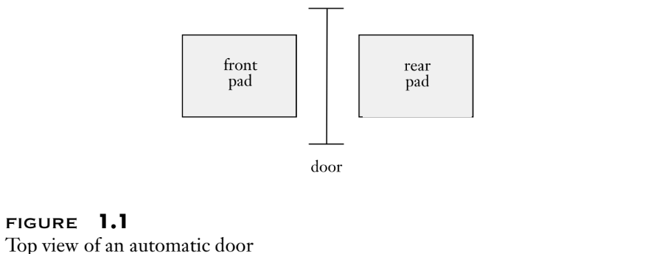
FSA (real life example) - Automatic Door Controller Top View

Slide 7
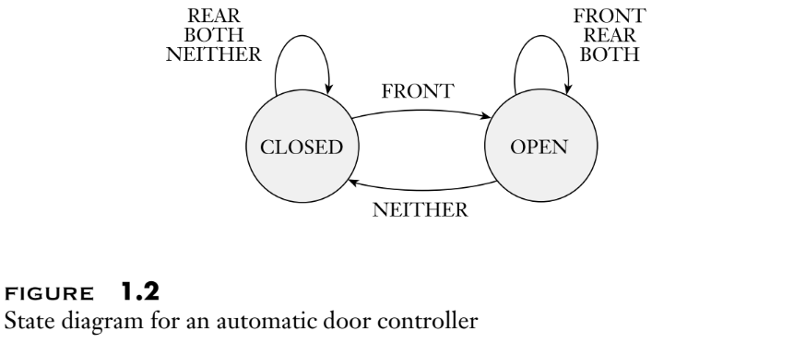
FSA (real life example) - Automatic Door Controller State Diagram

Slide 8
FSA (real life example) - State Diagram Description
The controller is in either of two states: “OPEN” or “CLOSED,” representing the corresponding condition of the door.
There are four possible input conditions:
  “FRONT” - a person is standing on the pad in front of the doorway,
  “REAR” - a person is standing on the pad to the rear of the doorway,
  “BOTH” - people are standing on both pads,
  “NEITHER” - no one is standing on either pad.

Slide 9
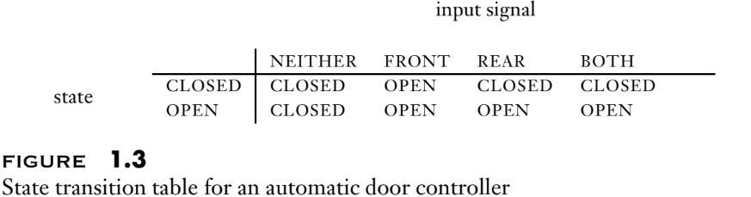
FSA (real life example) - Automatic Door Controller State Diagram

Slide 10
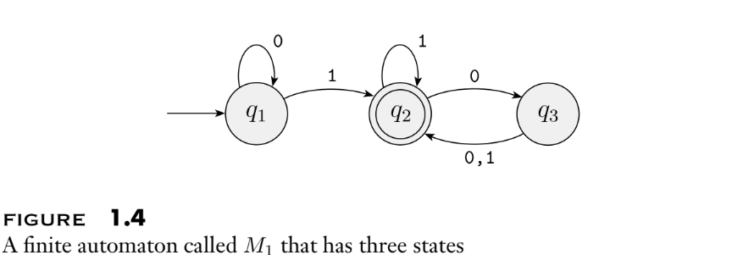
FSA (state diagram) - Machine M1 with three states

Slide 11
FSA (machine M1) - State Diagram Terminologies
Figure 1.4 is called the state diagram of M1.
It has three states, labeled q1, q2, and q3.
The start state, q1, is indicated by the arrow pointing at it from nowhere.
The accept state, q2, is the one with a double circle.
The arrows going from one state to another are called transitions.

Slide 12
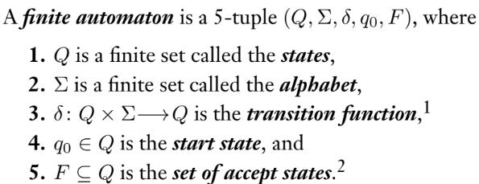
FSA (Formal Definition) - 5-Tuple

Slide 13
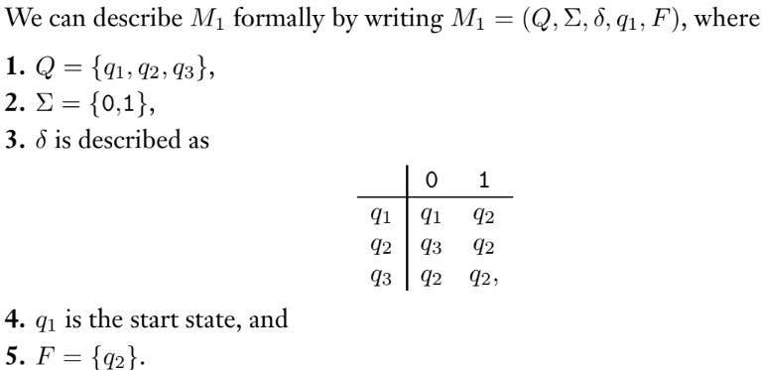
FSA (Formal Definition) - Machine M1

Slide 14
FSA (language of a machine) - Language of Machine M1
In our example, let
A = {w| w contains at least one 1 and an even number of 0’s follow the last 1}.
Then L(M1) = A, or equivalently, M1 recognizes A.
We can also write,
L(M1) = {w| w contains at least one 1 and an even number of 0’s follow the last 1}.

Slide 15
FSA (language of a machine) - Language Definition and Terms
If A is the set of all strings that machine M accepts, we say that A is the language of machine M and write L(M) = A.
We say that M recognizes A or that M accepts A.
Because the term accept has different meanings when we refer to machines accepting strings and machines accepting languages, we prefer the term recognize for languages in order to avoid confusion.
A machine may accept several strings, but it always recognizes only one language.

Slide 16
Practice Problems on DFAs

Slide 17
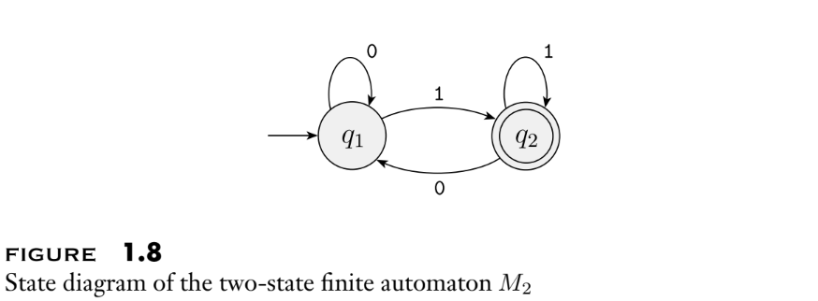
FSA (example 1) - Machine M2
Define M2 using the 5-tuple and also state the language of M2.

Slide 18
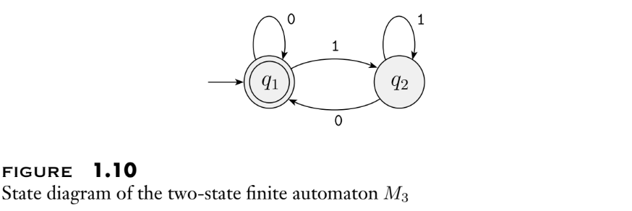
FSA (example 2) - Machine M3 Try Yourself
Define M3 using the 5-tuple and also state the language of M3.

Slide 19
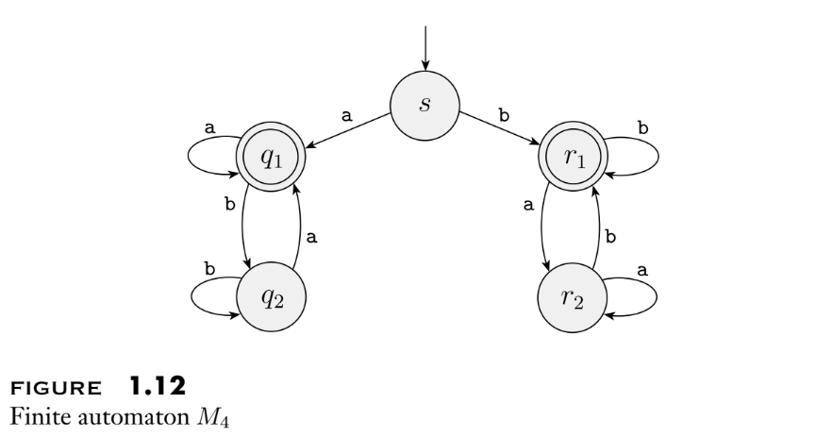
FSA (example 3) - Machine M4 Try Yourself
Define M4 using the 5-tuple and also state the language of M4.

Slide 20
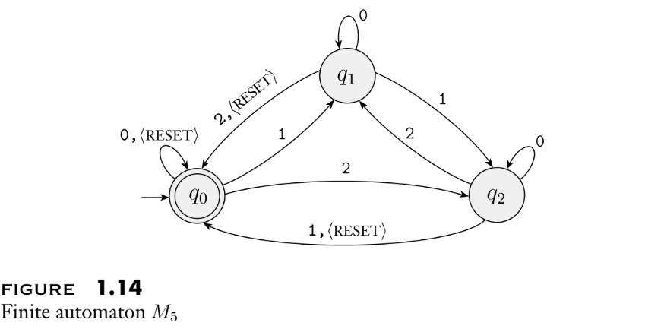
FSA (example 4) - Machine M5 Try Yourself
Define M5 using the 5-tuple and also state the language of M5. To be continued…

Slide 21
FSA (example 4) - Machine M5
Machine M5 keeps a running count of the sum of the numerical input symbols it reads, modulo 3.
Every time it receives the hRESETi symbol, it resets the count to 0.
It accepts if the sum is 0 modulo 3, or in other words, if the sum is a multiple of 3.

Slide 22
Formal Definition of Computation
Let M = (Q, Σ, δ, q0, F) be a finite automaton
let w = w1w2 · · · wn be a string where each wi is a member of the alphabet Σ.
M accepts w if a sequence of states r0, r1, . . . , rn in Q exists with three conditions:
  r0 = q0,
  δ(ri, wi+1) = ri+1, for i = 0, . . . , n − 1, and
  rn ∈ F.

Slide 23
Formal Definition of Computation contd…
Condition 1 says that the machine starts in the start state.
Condition 2 says that the machine goes from state to state according to the transition function.
Condition 3 says that the machine accepts its input if it ends up in an accept state.
We say that M recognizes language A if A = {w| M accepts w}.

Slide 24
Formal Definition of Computation (Example Machine M5)
Let w be the string:
  “10<RESET>22<RESET>012”
Sequence of states it enters when computing on w is:
  q0, q1, q1, q0, q2, q1, q0, q0, q1, q0.
satisfies the three conditions.
The language of M5 is:
  L(M5) = {w| the sum of the symbols in w is 0 modulo 3, except that <RESET> resets the count to 0}.

Slide 25
Designing DFAs

Slide 26
Design Principle (“Reader as Automaton” Theory)
Put yourself in the place of the machine you are trying to design,
See how you would go about performing the machine’s task.
Let’s try out this principle to two such machines.

Slide 27
General Steps for Designing any DFA
Think of a string which gets accepted by the language given.
Determine the different states needed to accept the string.
State rest of the transitions.
Mark the start state and accept state.

Slide 28
Designing DFA (example 1) - Machine recognizing odd number of 1s
Given Σ = {0, 1} and the language consists of all strings with an odd number of 1s. Draw a DFA that recognizes this language

Slide 29
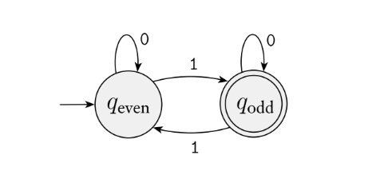
Designing DFA (example 1) - Solution

Slide 30
Designing DFA (example 2) - Accepting strings that contain 001
Given Σ = {0, 1} and the language consists of all strings that contain the string 001 as a substring. Draw a DFA that recognizes this language

Slide 31
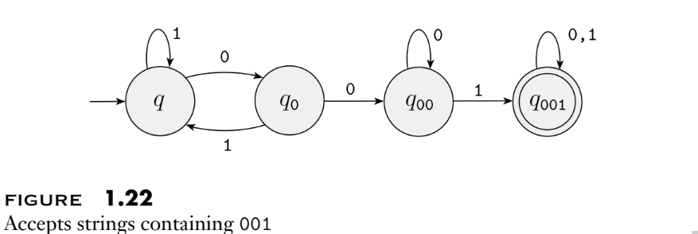
Designing DFA (example 2) - Solution

Slide 32
Designing DFA (example 3) - Accepting strings that starts with 11
L(A) = {w | w ∈ (0,1)* and w starts with 11} i.e {11, 110, 111, 1100, 1101.............}

Slide 33
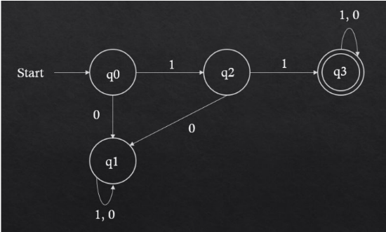
Designing DFA (example 3) - Solution
L(A) = {w | w ∈ (0,1)* and w starts with 11} i.e {11, 110, 111, 1100, 1101.............}

Slide 34
Designing DFA (example 4) - Accepting strings that ends with 11
L(A) = {w | w ∈ (0,1)* and w ends with 11} i.e. {11, 011, 111.............}

Slide 35
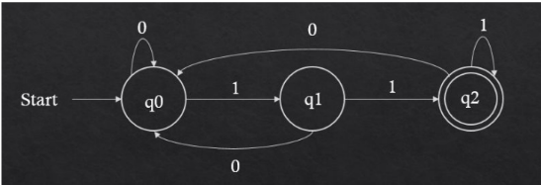
Designing DFA (example 4) - Solution
L(A) = {w | w ∈ (0,1)* and w ends with 11} i.e. {11, 011, 111.............}

Slide 36
Designing DFA (example 5) - length of the string at least 2
L(A) = {w | w ∈ (0,1)* and |w| ≥ 2} i.e. length of the string is at least 2

Slide 37
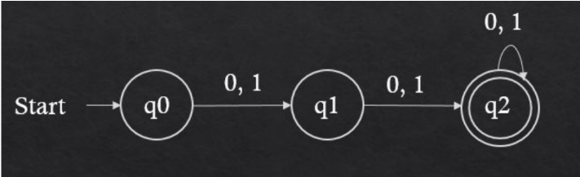
Designing DFA (example 5) - Solution
L(A) = {w | w ∈ (0,1)* and |w| ≥ 2} i.e. length of the string is at least 2

Slide 38
Designing DFA (example 6) - length of the string at = 2 or at most 2
L(A) = {w | w ∈ (0,1)* and |w| = 2} i.e. length of the string is 2
L(A) = {w | w ∈ (0,1)* and |w| < 2} i.e. length of the string is at most 2
Try Yourself

Slide 39
Designing DFA (example 7) - binary integer divisible by 5
L(A) = {w | w ∈ (0,1)* and w as a binary integer is divisible by 5}

Slide 40
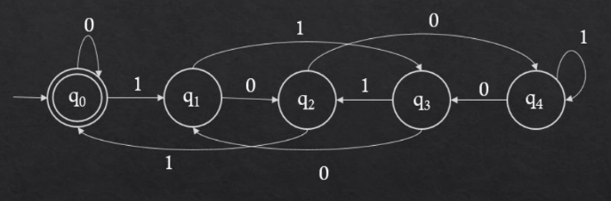
Designing DFA (example 7) - Solution
L(A) = {w | w ∈ (0,1)* and w as a binary integer is divisible by 5}

Slide 41
Regular Operations

Slide 42
Regular Operations
Let A and B be languages.
We define the regular operations union, intersection, concatenation, complement and star as follows:
  Union: A ∪ B = {x| x ∈ A OR x ∈ B}.
  Intersection: A ∩ B = {x| x ∈ A AND x ∈ B}.
  Concatenation: A ◦ B = {xy| x ∈ A and y ∈ B}.
  Complement: A` = {x| x ∉ A}.
  Star (Kleen Closure): A∗ = {x1x2 . . . xk| k ≥ 0 and each xi ∈ A}.

Slide 43
Regular Operations (Example)
Let the alphabet Σ be the standard 26 letters {a, b, . . . , z}.
If A = {good, bad} and B = {boy, girl, good}, then:
  A ∪ B = {good, bad, boy, girl},
  A ∩ B = {good},
  A ◦ B = {goodboy, goodgirl, goodgood, badboy, badgirl, badgood},
  A` = {good, bad}` and
  A∗ = {ε, good, bad, goodgood, goodbad, badgood, badbad, goodgoodgood, goodgoodbad, goodbadgood, goodbadbad, . . . }.

Slide 44
Definition of Closed Under any operation
Let N = {1, 2, 3, . . . } be the set of natural numbers.
When we say that N is closed under multiplication, we mean that for any x and y in N , the product x × y also is in the set N.
In contrast, N is not closed under division, as 1 and 2 are in N but 1/2 is not.
Generally speaking, a collection of objects is closed under some operation if applying that operation to members of the collection returns an object still in the collection.

Slide 45
The Cross Product

Slide 46
Closure of Regular Languages Under Union: The Cross Product Construction (Theorem)
The class of regular languages is closed under the union operation.
In other words, if A1 and A2 are regular languages, so is A1 ∪ A2 and A1 ∩ A2.

Slide 47
The Cross Product: Between A1 and A2
The cross product is the process of constructing a DFA that simulates the steps of two different DFAs in parallel.
Let the two DFAs be A1 and A2 accepting regular languages L1 and L2;
  A1 = (Q1, Σ, δ1, q01, F1) recognized my machine A1,
  A2 = (Q2, Σ, δ2, q02, F2) recognized by machine A2.

Slide 48
The Cross Product: DFA A From A1 and A2
From these two DFAs, we can construct a DFA, A = (Q, Σ, δ, q0, F) that recognizes
  A1 ⋃ A2,
  A1 ⋂ A2
For the DFA, the 5-tuple A = (Q, Σ, δ, q0, F):

Slide 49
The Cross Product: Set of States, the Start State, Transition Function
Set of states
  Q is the set of states. It contains pairs of states from A1 and A2
  Q = Q1 X Q2 = {(q1, q2)| q1 ∈ Q1 and q2 ∈ Q2}
Start State
  q0= (q01, q02)
Transition Function
  δ((q1, q2), a) = (δ1(q1, a), δ2(q2, a)) where q1 and q2 are states of A1 and A2 respectively and (q1, q2) represents the state of the new DFA, A that is derived from A1 and A2.

Slide 50
The Cross Product: Set of Final States
Set of final states
  For A = A1 ⋃ A2, F = {(q1, q2) | q1 ∈ F1 OR q2 ∈ F2}, it accepts when either A1 or A2 accepts Q = Q1 X Q2 = {(q1, q2)| q1 ∈ Q1 and q2 ∈ Q2}
  For A = A1 ⋂ A2, F = {(q1, q2) | q1 ∈ F1 AND q2 ∈ F2}, it accepts when both A1 and A2 accepts

Slide 51
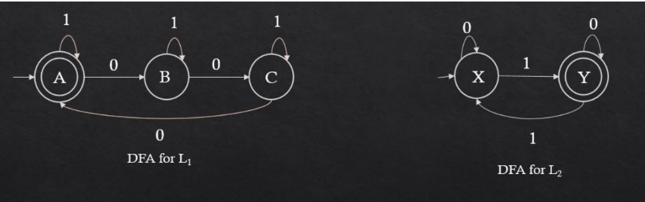
The Cross Product: Example
Let’s consider the DFAs for the following languages:
  L1 = {w | w ∈ (0,1)* and n0(w) is divisible by 3} i.e. the number of 0 is divisible by 3
  L2 = {w | w ∈ (0,1)* and n1(w) is odd} i.e. the number of 1 is odd.

Slide 52
The Cross Product: Example Explanation
Here:
  The set of states for the first DFA, Q1 = {A, B, C} the second DFA, Q2 = {X, Y}
  Start state of the first DFA is A and the second DFA is X
  Set of final states of the first DFA is F1 = {A} and the second DFA is F2 = {Y}

Slide 53
The Cross Product: Example Solution for the new DFA
Set of States:
  The set of states is, Q = Q1 X Q2 = {(A, X), (A, Y), (B, X), (B, Y), (C, X), (C, Y) }
  For simplicity, let’s name the states as AX, AY, BX, BY, CX, CY. So, Q = {AX, AY, BX, BY, CX, CY}
Start state is the state that corresponds to (A, X), which is AX
  Set of final states of the first DFA is F1 = {A} and the second DFA is F2 = {Y}
Set of Final States:
  If L = L1 ⋃ L2 = {w | w ∈ (0,1)* and the n0(w) is divisible by 3 OR n1 (w) is odd}, F = {AX, AY, BY, CY}
  If L = L1 ⋂ L2 = {w | w ∈ (0,1)* and the n0(w) is divisible by 3 AND n1 (w) is odd}, F = {AY}

Slide 54
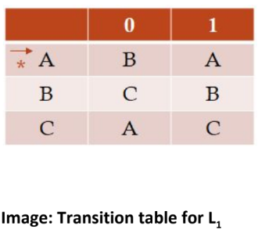
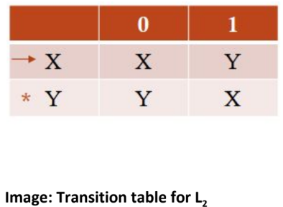
The Cross Product: Example Solution for the new DFA (The Transitions)
The Transitions:
  We can figure out the transitions for the new DFA from the transitions of the two DFAs it simulates. It is easier to see from the transition tables.

Slide 55
The Cross Product: Example Solution for the new DFA (The Transitions) contd…
Transitions of new DFA (for input symbol 0):
  δ(A, 0) = B and δ(X, 0) = X. So, δ(AX, 0) = BX
  δ(B, 0) = C and δ(X, 0) = X. So, δ(BX, 0) = CX
  δ(C, 0) = A and δ(X, 0) = X. So, δ(CX, 0) = AX
  δ(A, 0) = B and δ(Y, 0) = Y. So, δ(AY, 0) = BY
  δ(B, 0) = C and δ(Y, 0) = Y. So, δ(BY, 0) = CY
  δ(C, 0) = A and δ(Y, 0) = Y. So, δ(CY, 0) = AY

Slide 56
The Cross Product: Example Solution for the new DFA (The Transitions) contd…
Transitions of new DFA (for input symbol 1):
  δ(A, 1) = A and δ(X, 1) = Y. So, δ(AX, 1) = AY
  δ(B, 1) = B and δ(X, 1) = Y. So, δ(BX, 1) = BY
  δ(C, 1) = C and δ(X,1) = Y. So, δ(CX, 1) = CY
  δ(A, 1) = A and δ(Y, 1) = X. So, δ(AY, 1) = AX
  δ(B, 1) = B and δ(Y, 1) = X. So, δ(BY, 1) = BX
  δ(C, 1) = C and δ(Y, 1) = X. So, δ(CY, 1) = CX

Slide 57
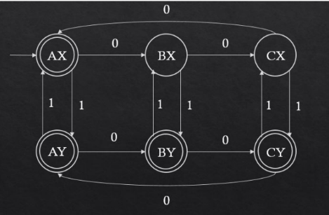
The Cross Product: New DFA for L1 ⋃ L2
The DFA for L = L1 ⋃ L2 = {w | w ∈ (0,1)* and the n0(w) is divisible by 3 OR n1(w) is odd}:

Slide 58
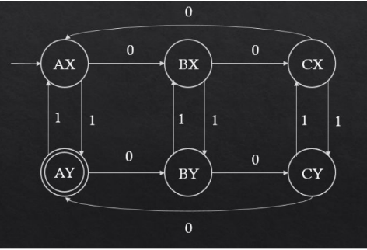
The Cross Product: New DFA for L1 ⋂ L2
The DFA for L = L1 ⋂ L2 = {w | w ∈ (0,1)* and the n0(w) is divisible by 3 AND n1(w) is odd}:

